Slide 1

MACHINE LEARNING
LIVE SESSION

Slide 2
BOOTCAMP STRUCTURE
DAY 1 - PANDAS AND NUMPY
DAY 6-POLYNOMIAL REGRESSION
DAY 11 - NAIVE BAYES
DAY 2 - MATPLOTLIB AND SEABORN
DAY 7 - LOGISTIC REGRESSION
DAY 12 - KNN
DAY 3 - DATA ANALYSIS / EDA
DAY 8 - DECISION TREE
DAY 13 - SVM
DAY 4 - MACHINE LEARNING
DAY 9 - RANDOM FOREST
DAY 14- CLUSTERING ALGORITHMS
DAY 5 - LINEAR REGRESSION
DAY 10 - XG BOOST
DAY 15 - DEPLOYING MODELS

Slide 3
Supervised Machine Learning
Price of house ?
Price of cars ?
How many seconds user is going to watch a video?
REGRESSION
Fraud, Not-fraud
Male or Female
Dog or Cat
Spam , Not spam
CLASSIFICATION
Predict Continuous values
Predict Discrete values

Slide 4
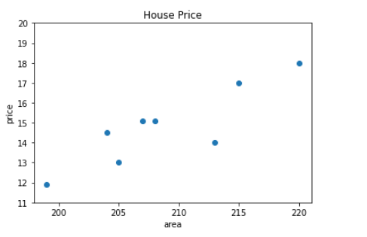
LINEAR REGRESSION
AREA (sqft.) | PRICE(Lakh)
199 | 11.9
204 | 14.5
205 | 13
207 | 15.4
208 | 15.1
215 | 17
220 | 18
213 | 15
210 | ?

Slide 5
Draw a best fit line which can better estimate house prices.

Slide 6
We can draw so many lines how to decide the best one ?

Slide 7
A line which is at minimum distance from each point.

Slide 8
EQUATION OF A LINE
y = mx + c
y-axis
y = mx + c
m = slope
x = variable
c = intercept
x-axis

Slide 9
y-axis
y = mx + c
x-axis

Slide 10
y-axis
y = mx + c
x-axis

Slide 11
y-axis
y = mx + c
x-axis

Slide 12
y-axis
y = mx + c
x-axis

Slide 13
y-axis
y = mx + c
x-axis

Slide 14
y-axis
y = mx + c
x-axis

Slide 15
y-axis
y = mx + c
x-axis

Slide 16
y-axis
y = mx + c
x-axis

Slide 19
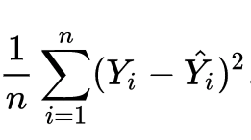
error

Slide 20
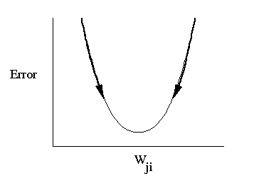
GRADIENT DESCENT
m

Slide 21
Number of variables in simple linear regression:
We have one independent variable (X)
We have one dependent variable (Y)
y = a0 + a1*x – e

Slide 22
m

Slide 23
AREA (sqft.) | PRICE (Lakh) | Age | City
199 | 11.9 | 2 | Banglore
204 | 14.5 | 1 | Delhi
205 | 13 | 0 | Chennai
207 | 15.4 | 3 | Mumbai
208 | 15.1 | 5 | Chennai
215 | 17 | 7 | Mumbai
220 | 18 | 2 | Delhi
213 | 15 | 1 | Mumbai
MULTIPLE LINEAR REGRESSION
y = m1x1 + m2x2 + m3x3 + c

